Slide 1

CREATIVE DESIGN DOCUMENT
Throwaway

Slide 2
Art Direction Overview
· Style
Fantasy in the vein of Alice in Wonderland and Avatar (The Movie)
· Theme & Setting
Medieval/Fantasy Era as most RTS games are set in this period. However this is twisted with our use of characters and other tropes (Infestation, Mushroom enemies).
· Characters
Art Style Enemies are represented as horrific amalgamations of a foreign alien infection combined with the worlds various creatures and plant life. Wongles are designed to look like approachable and friendly humanoids.

Slide 3
Strengths
· Textures & Materials
· Daytime Scene & Nighttime Scene
· Clear silhouettes
Weaknesses
· Communication
· Art style is not cohesive

Slide 4
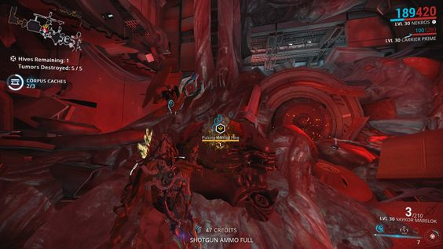
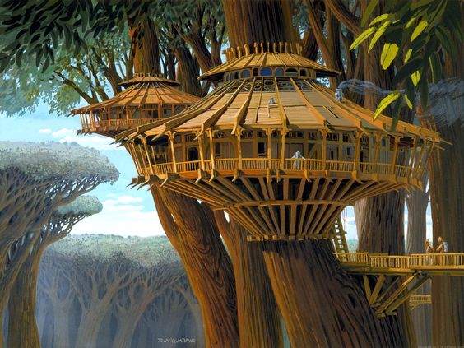
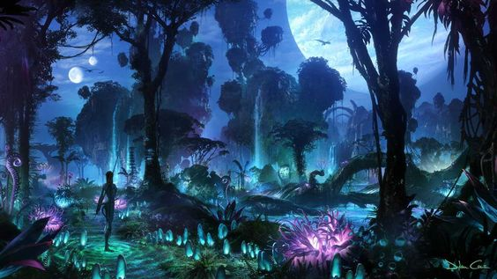
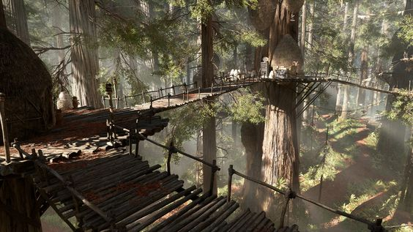
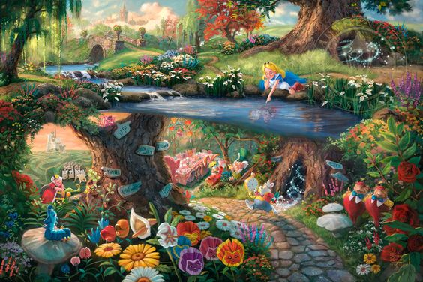
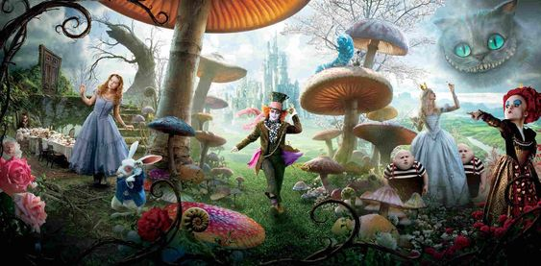
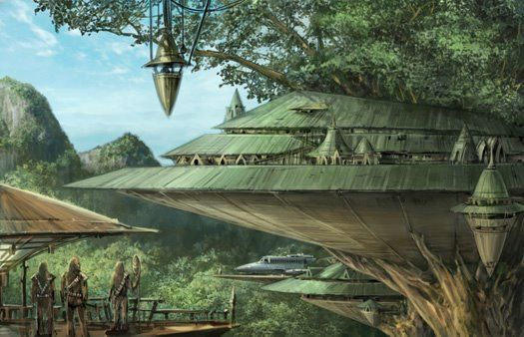
General Moodboard [Overall Feel of the game]

Slide 5
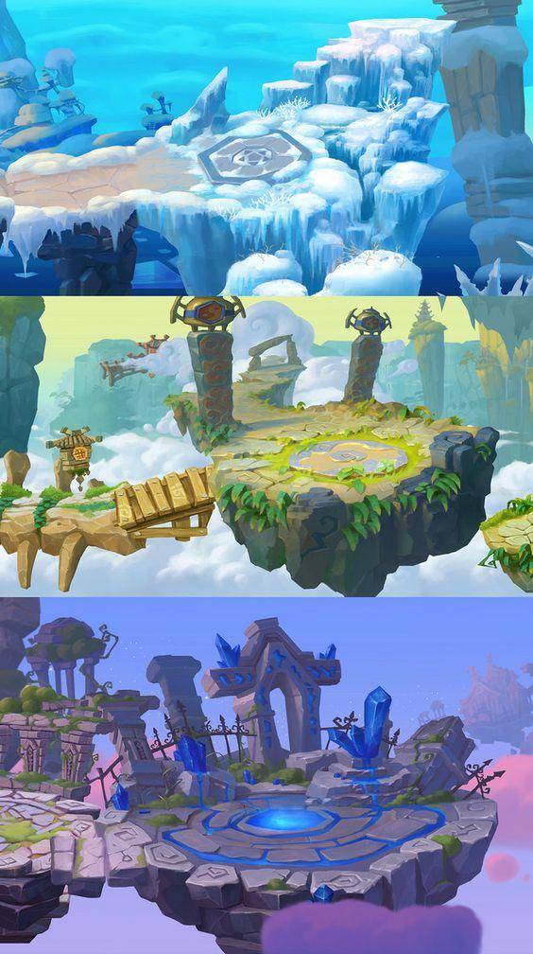
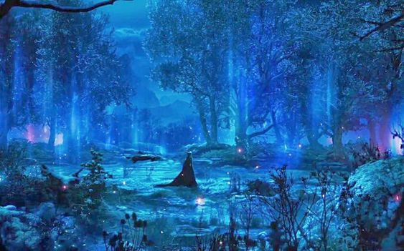
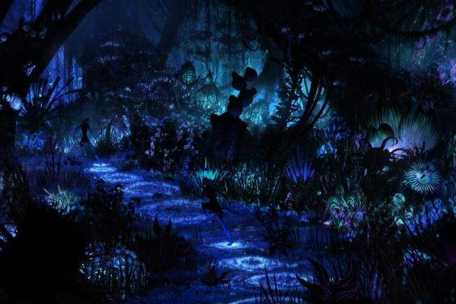
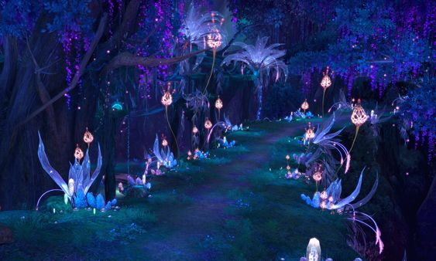
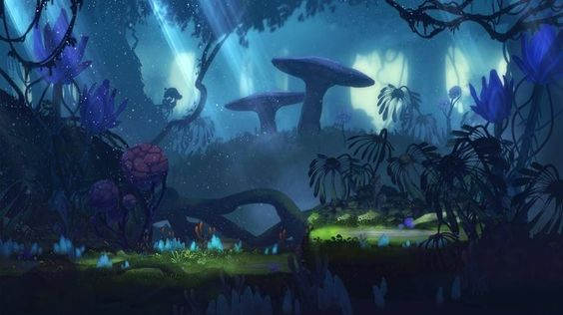
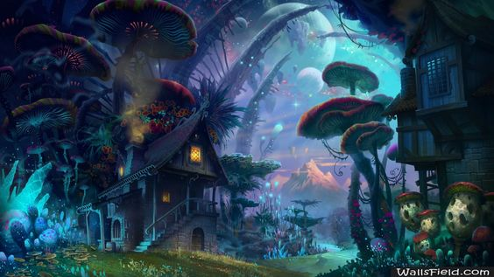
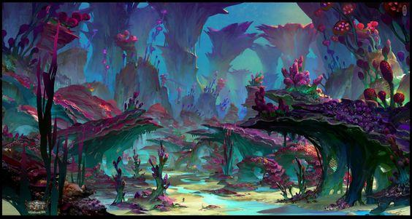
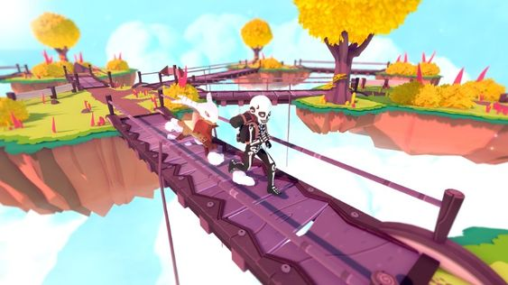
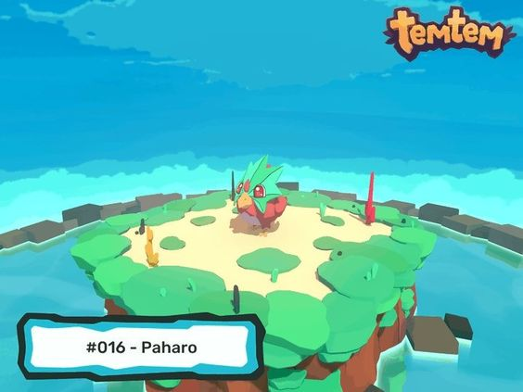
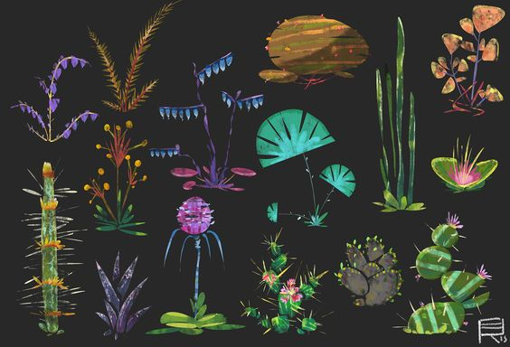
Environment Art Direction

Slide 6
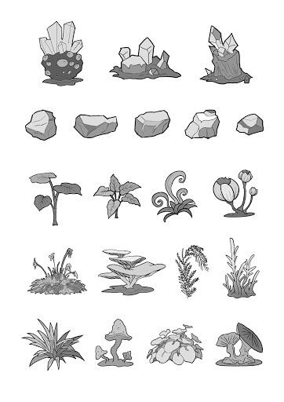
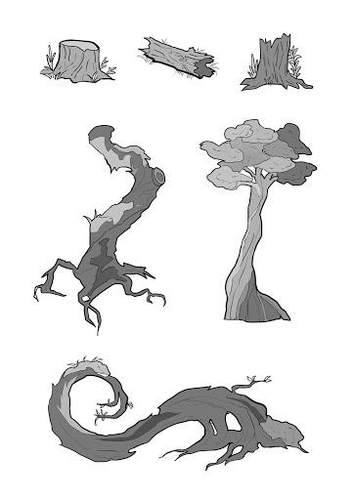
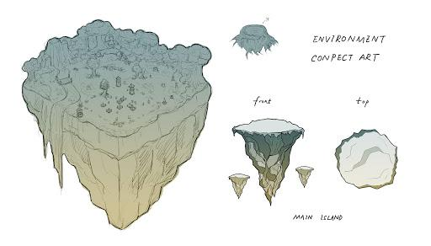
The Concept Art
· Floating Island
· New plants, rocks, trees
· New environment

Slide 7
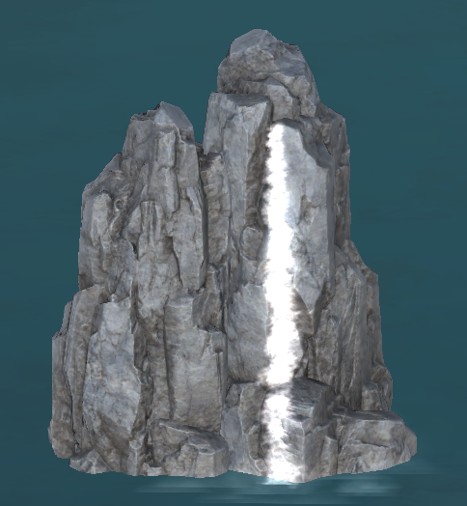
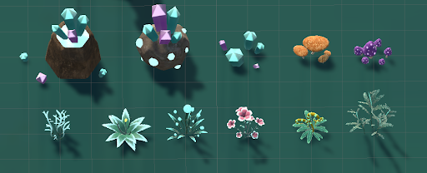
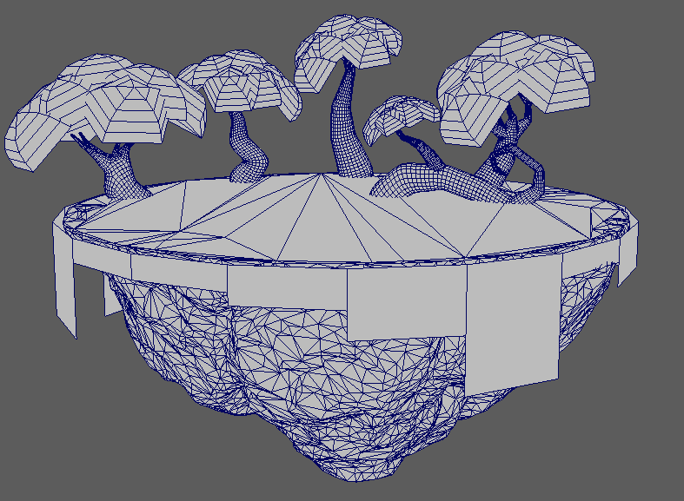
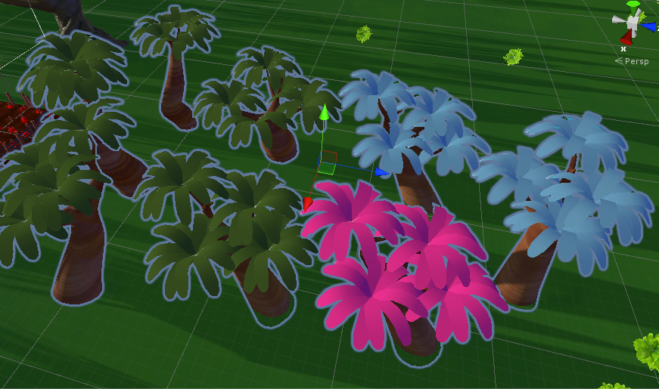
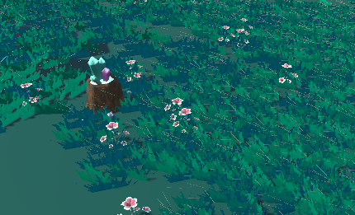
Environment Assets Design
· Plants
· Trees
· Crystals
· Rocks
· Mountain
· Bridge
· Grasses

Slide 8
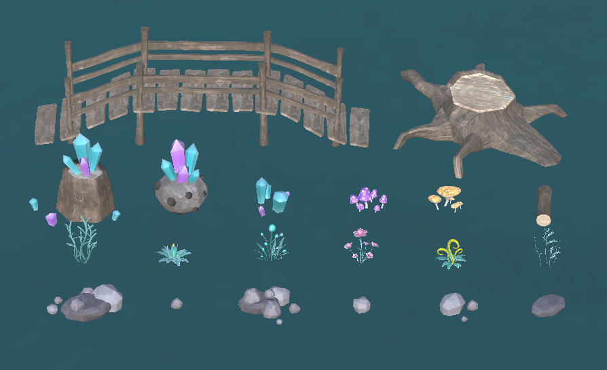
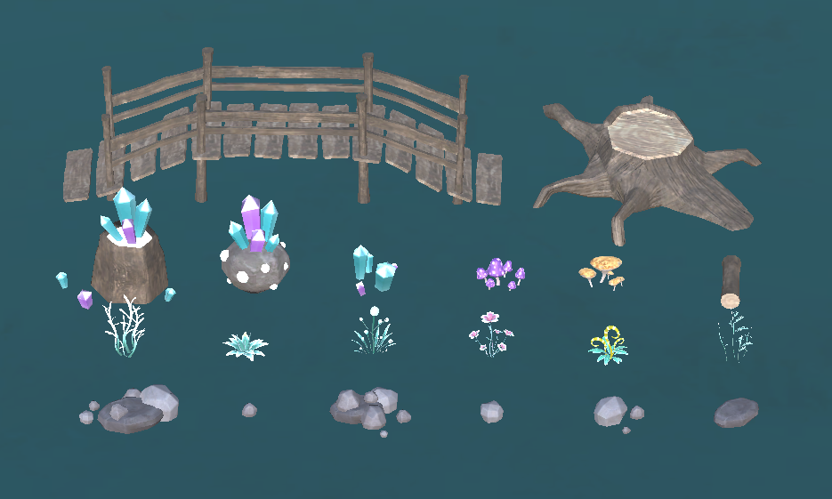
Textures & Materials
Add emissive maps for the nighttime scene.
· Daytime
· Nighttime

Slide 9
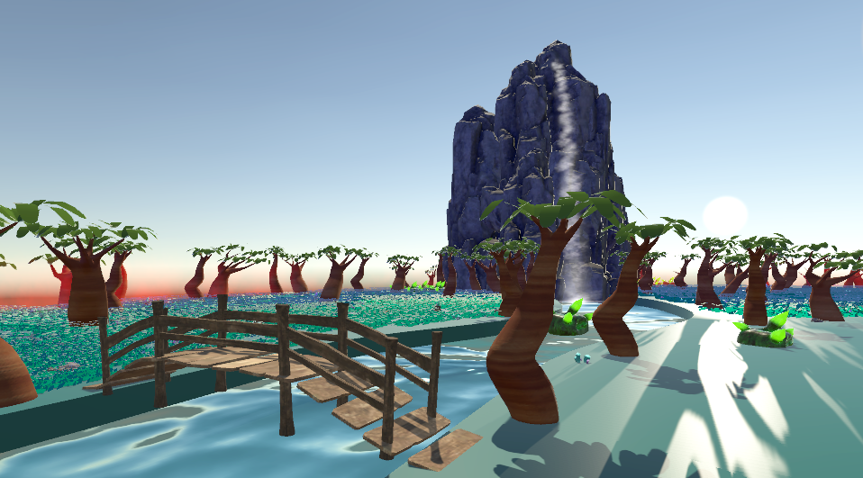
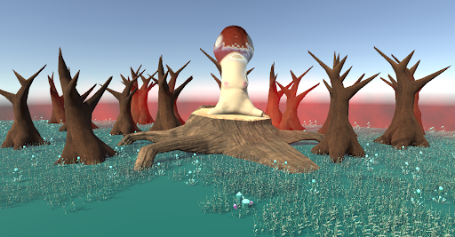
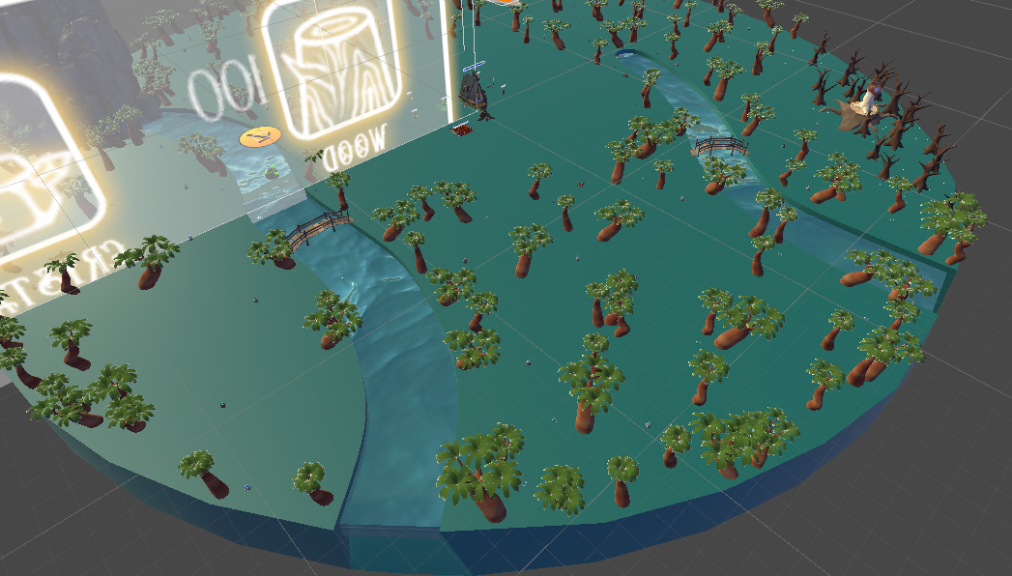
Game Environment Design
New game environment layout.
· Add rivers
· Add new assets

Slide 10
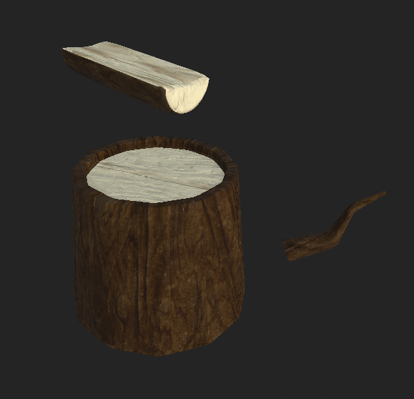
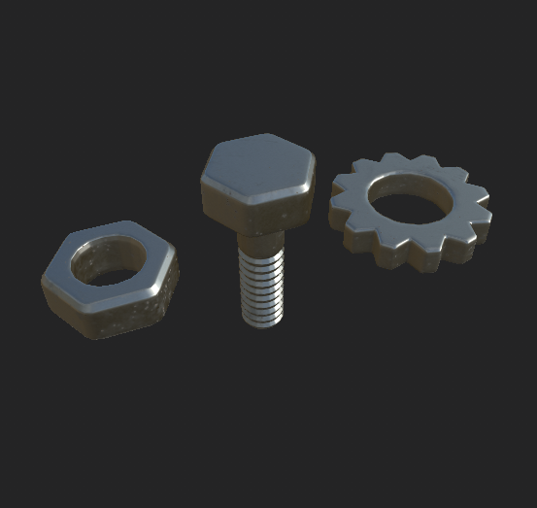
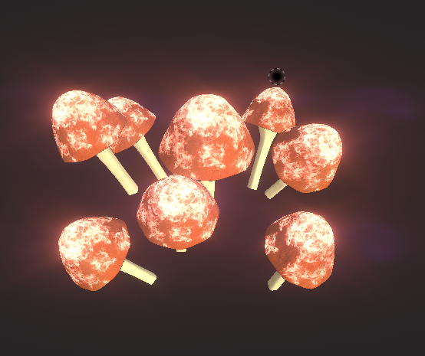
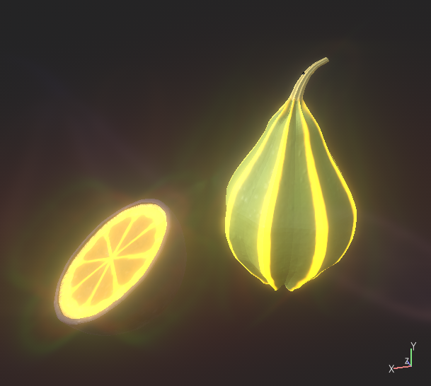
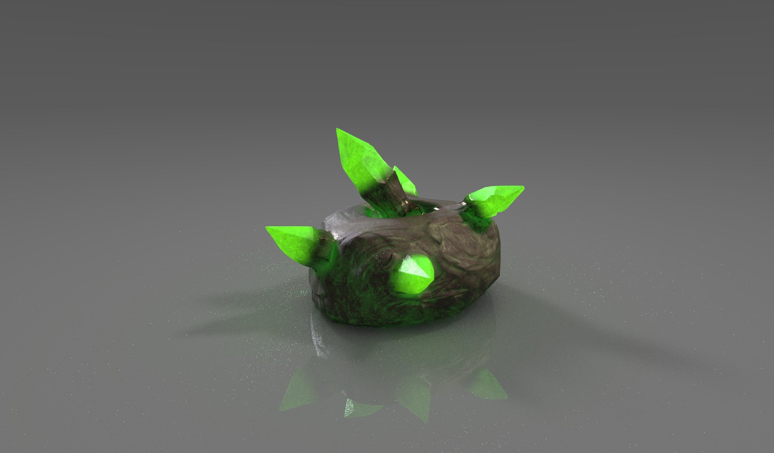
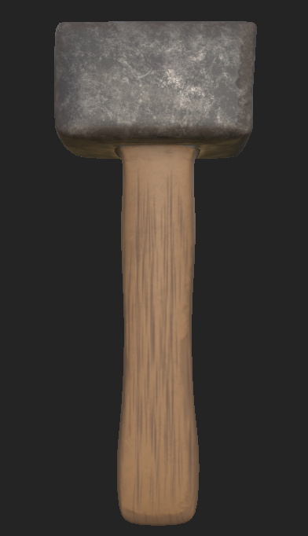
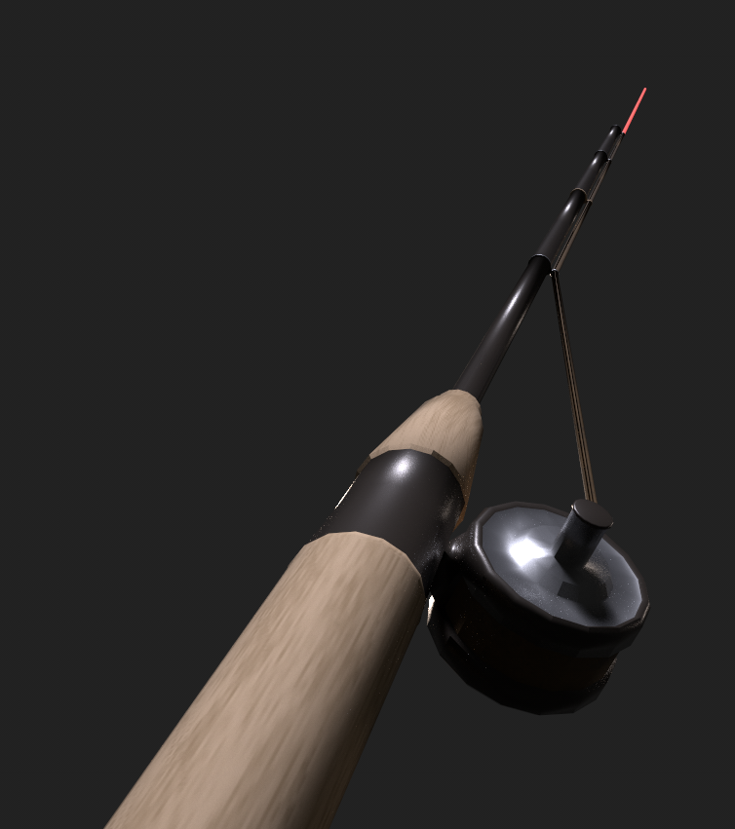
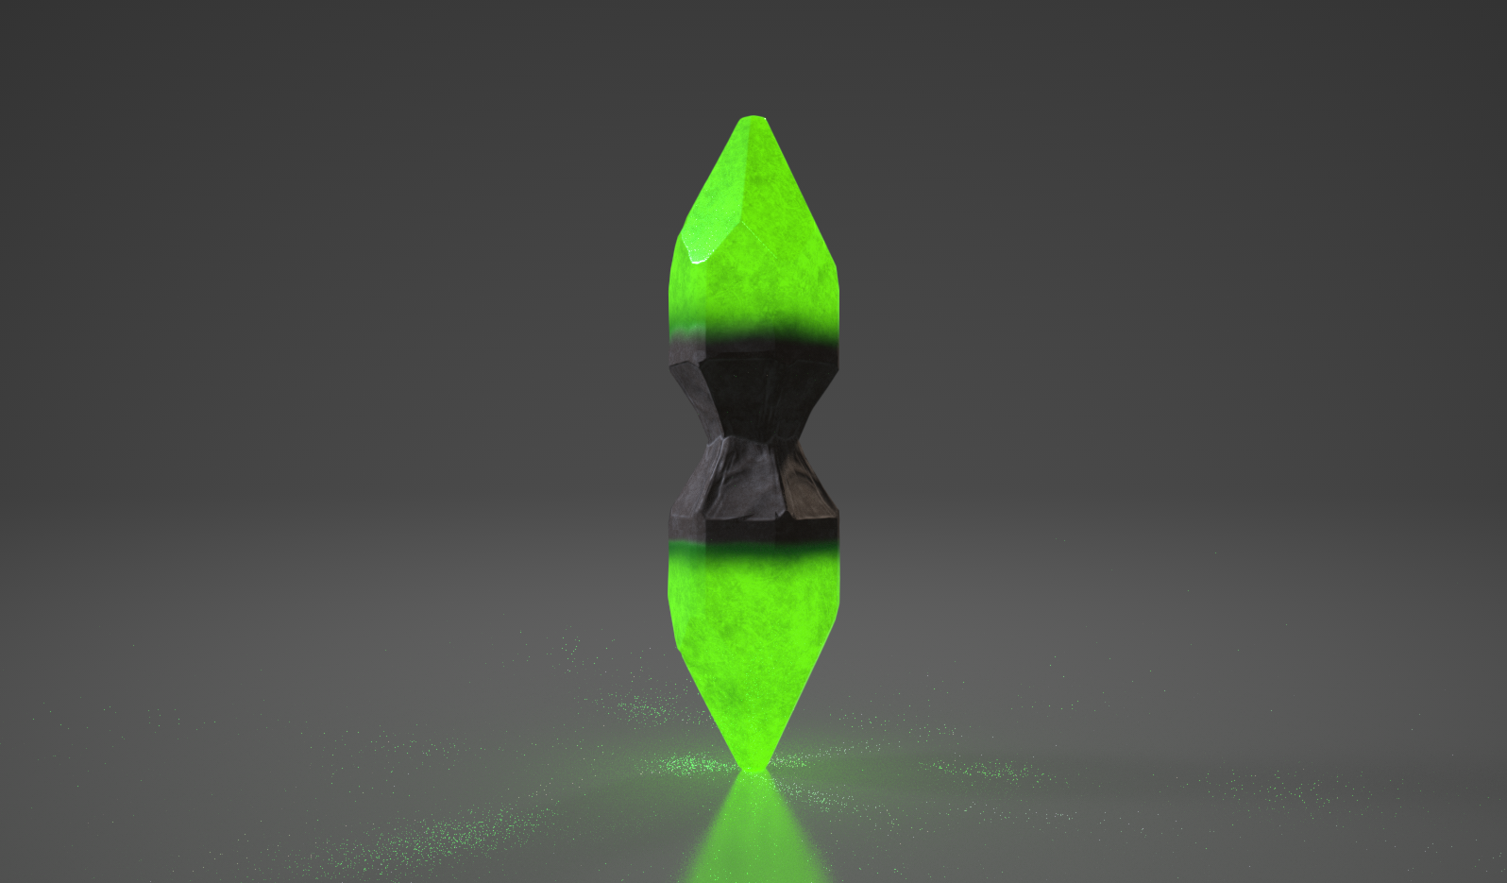
Resource Assets Design
Wongles can be sent to collect resources
· Wood
· Metal
· Mushroom
· Food
· Geiger Strain (From crystal nodes)
· Hammer
· Fishing Rod

Slide 11
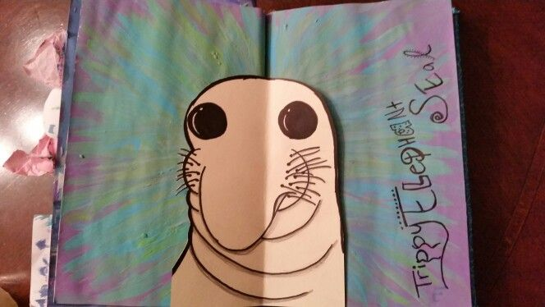
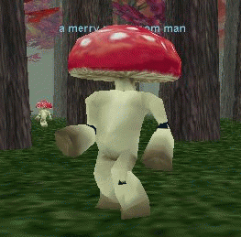
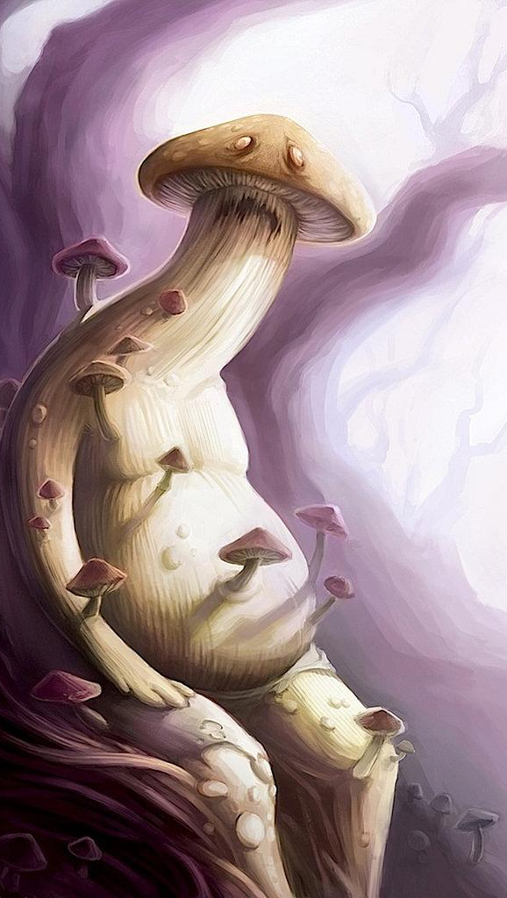
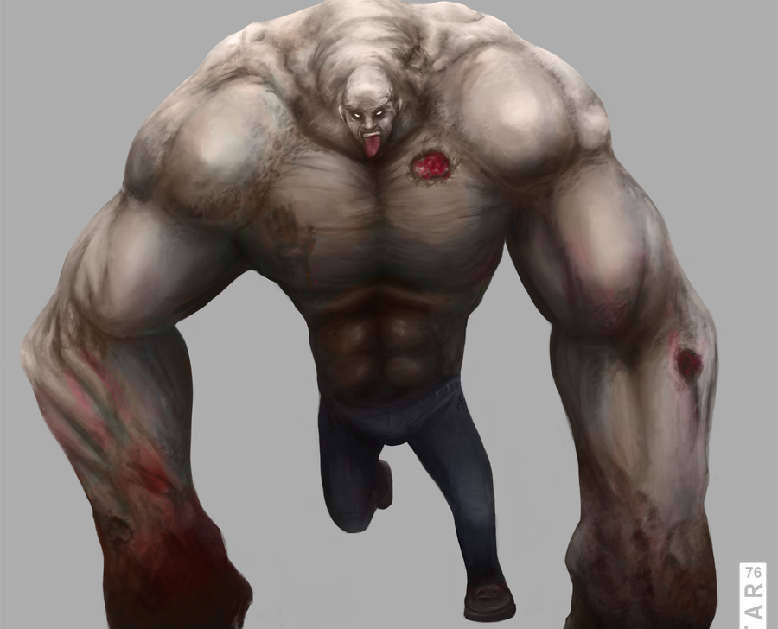
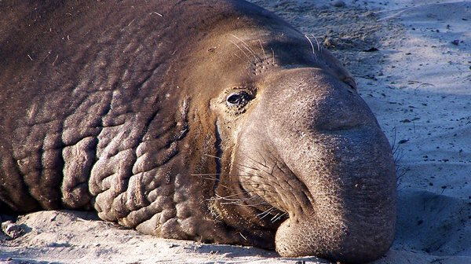
Character Moodboard Reference

Slide 12
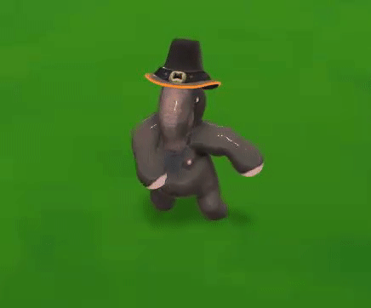
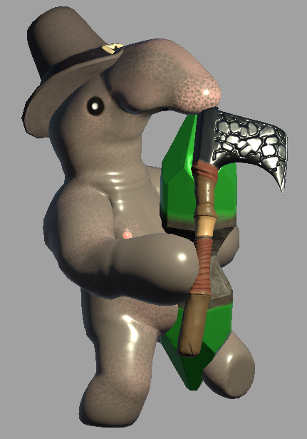
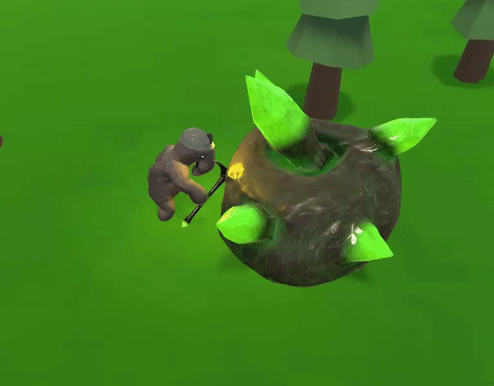
Wongle Character Process
Designed to be cute, visually distinct to the game
· Unit variations expressed through tool usage/hats
· Original design inspired by psychedelic art
· Adapted to a fantasy setting
· New animations created for task variety

Slide 13
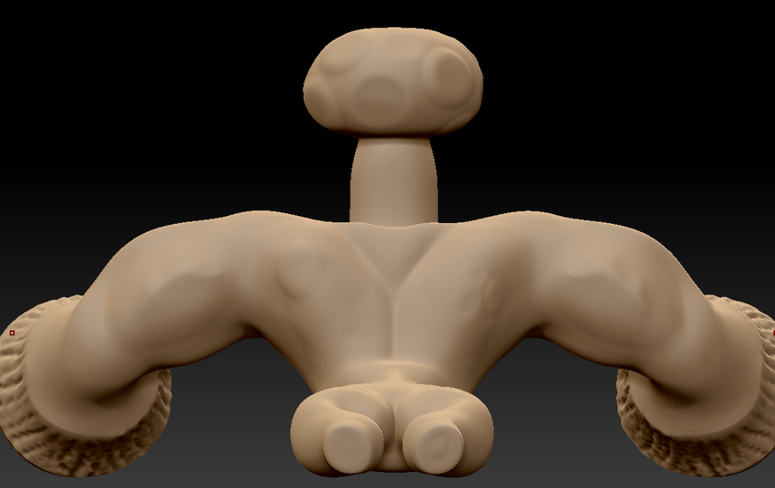
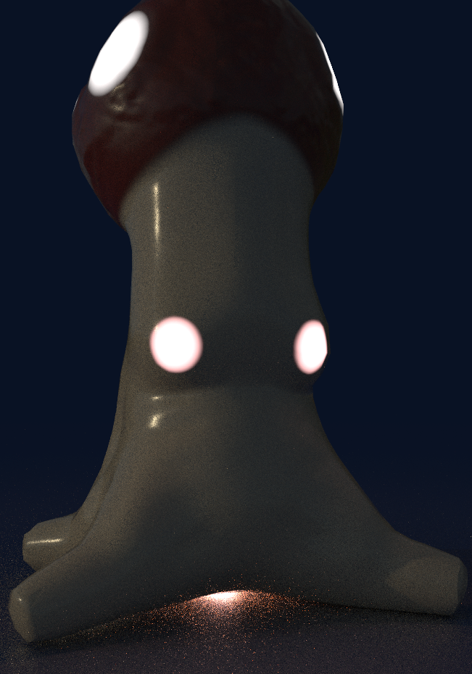
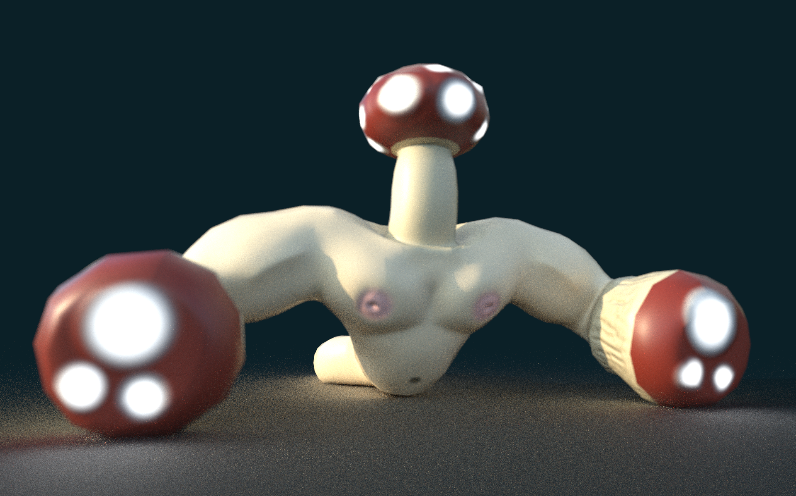
Mushroom Character(s) Process
Designed to be hulking, visually intimidating compared to wongles
· Created to overwhelm defenses
· Mushroom design inspired by psychedelic art
· Theme of nature adapted around these creatures
· New unit; The Broodshroom created as a mobile spawn point

Slide 14
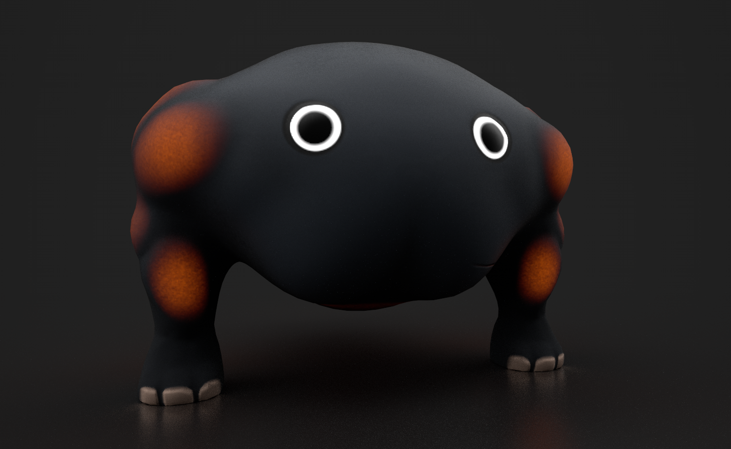



New Warrior Unit
· Deadly War Scrungus
· Deep One
While the skin changes did make a difference, players were still confused by the fact that wongle units didn't all share the capacity to work on resource farming. Players would often have a warrior selected, and become confused when they wouldn't mine a crystal, or work on a farm.
In creating a new model/animation for the warriors, we can very clearly distinguish the warrior units from the workers, and hopefully resolve the issue of players confusing their functions.

Slide 15



New Wongle Variant Skins
New Textures for the base Wongle that allow for unit distinction
After multiple revisions, this addition contains three new skins for unit variation.
· One for the melee (warrior) unit.
· One for the ranged (wizard) unit.
· One for the converted (corrupted) unit.
This should allow for people to distinguish unit roles more clearly.

Slide 16




Fishing Object
A creature that can be pulled out of the water and carried back to base, representing collected food via fishing.

Slide 17





Tool/Hat Design
Created to represent different roles/tasks between units
· Woodcutting
· Mining
· Farming (Gathering)
· Patrolling
· Attacking (Melee/Ranged)
· Evidence of the research/upgrade system
· Emission/Silhouette helps distinguish units/tasks at night
· Fishing Hat

Slide 18







Menu Design
Menu Reference
Old
New
· Fantasy feeling
· Only one main color for the main menu(White)
· Use yellow out glow to make the UI more clear
· Option button should be really clear
· Setting
(Master, Music, Sound Fx, Resolution, Screen Size)
· Play
· Exit

Slide 19


UI Design
Old
New
Color choice
· White for text
· Grey for background
Art style
· Fantasy
· Fit the vein of Alice in Wonderland and Avatar
The intent is to modify the UI to improve overall readability, and the usage of space. This may lead to the generation of some extra UI assets but this isn't the intent initially.

Slide 20






Minimap Icons
Developed a series of minimap icons to represent key resources, and player/enemy units.
Before there were simply a series of large squares that did a poor job of communicating the number of units a player had, and did not clearly highlight mining points of interest, nor distinguish different units (including the enemy) from one another.
These icons are a first pass at improving this.

Slide 21









VFX Design (Particles Effects)
· Waterfall
· Projectile
· Placed farm
· Farm explosion
· Enemy obscuring
· Farmed resources
· Enemy explosion
· Leaves and butterflies for daytime scene
· Fog, fire and fireflies for nighttime scene

